Slide 1

Predictive Maintenance of Airlines
Team Procrastinators:
Mayank Kilhor 18BCI0136
Chainathan 18BCD7130
Shelly Mohanty 19BCE0820
Saif Ali Nadaf H 19BEC0159

Slide 2
Introduction
Aircraft maintenance is an integral part of ensuring an aircraft is safe for operations. Poor maintenance planning can lead to devastating financial results for air carriers and keep aircraft grounded, passengers waiting and can even lead to flight cancellations. Additionally, an inaccurate overview of maintenance causes overstocking of surplus aircraft parts, resulting in air carriers losing vast sums of money.
To increase operational reliability and cost saving measures, aircraft operators follow aircraft maintenance programs. There are three well-known types of maintenance: reactive, preventive and predictive. Reactive maintenance refers to a timeline in which a particular part of an aircraft is used to its limits and repairs are only performed after a failure. This method is usually costly and dangerous for operational safety. Therefore, many aircraft operators use preventive aircraft maintenance (PM), also known as planned maintenance, which refers to a determined timeline of checks on certain airplane components.
The obvious challenge for carriers is a focused execution, which produces tangible and demonstrable improvements in cost and reliability. For OEMs accelerating adoption and profitably monetizing investments in predictive maintenance will be a significant challenge.
Another primary concern is data security. Due to the enormous amount of data that needs to be processed, it is critical to guarantee that equipment performance data cannot be accessed by outside parties, and that outside parties are not able to control predictive maintenance systems

Slide 3
Problem Statement
The airport is currently carrying scale increases year by year, the traditional method of airport resource allocation has been unable to adapt to the requirements of the operation of the airport. Dynamic allocation and scheduling of airport terminal passenger service resources are one of the most effective ways to improve passenger service levels and operational efficiency within the terminal, while the relatively accurate passenger traffic forecasting is the prerequisite for dynamic allocation and scheduling.

Slide 4
Solution
In this project, we have developed a model to predict the number of international airline passengers in units of 1000, given a year and a month.
The data ranges from January 1949 to December 1960, or 12 years, with 144 observations. Prediction for next months is computed based on current year and month traffic.
Dataset link:
https://www.kaggle.com/chirag19/air-passengers
RNN and LSTM have been used in the development of the model and we have used Flask to deploy the model as a web application.

Slide 5
Experimental Investigations
Data Collection.
Collect the dataset or create the dataset.
Data Preprocessing.
Import the libraries
Reading the dataset
Handling missing values
Data Visualization
Split the data into train and test
Normalize the data
Reshape the train and test data

Slide 6
Experimental Investigations
Model Building
Import the model building Libraries
Initializing the model
Adding LSTM Layer
Adding Output Layer
Configure the Learning Process
Training and testing the model
Optimize the Model
Save the Model
Application Building
Build HTML page.
Build Python code.

Slide 7
Hardware and Software Specifications
Libraries
Pandas
Numpy
Matplotlib
Seaborn
Keras
Tensorflow
Sklearn
Software Requirements
CPU: RAM 4GB
GPU: Memory 2GB

Slide 8
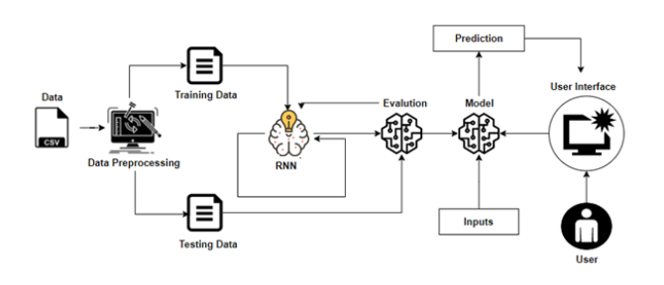
Flowchart

Slide 9
Conclusion
In this project, we presented an effective RNN based predictive maintenance solution for predictive maintenance of airlines. The model uses LSTM for predicting the number of passengers in the near future. The model created is shown to have very low loss rate and high overall accuracy.

Slide 10
Future Scope
As part of the future work, we would investigate additional data sources, and expand our model to predict a large number of different parameters so that airlines can remain well- maintained.

